Slide 1
Knowing the publics and messages
Ch- 6

Slide 2
Target audience
Having answered the question ‘Where am I going?’ by setting achievable aims and objectives, the next question to ask is ‘Who shall I talk to?’

Slide 3
Public Opinion
Public opinion represents a consensus, which emerges over time, from all the expressed views that cluster around an issue in debate, and that this consensus exercises power.

Slide 4
Public opinion
Public opinion works two ways: it is both a cause and effect of public relations activity.
For example, increasing concerns for the environment has affected the motor and furniture industries.
On the other hand, a stated objective of many public relations programmes is to affect the general public and often this means or implies affecting public opinion, often by mounting a media relations campaign. The commonly held view is that public opinion is ‘what is in the media’ and if what the media says can be affected, public opinion will also change because the media help to set the public agenda.

Slide 5
TYPES OF PUBLICS
Non-publics, which are groups that neither are affected by nor affect the organization. For example, a retailer based in southern India will have no effect on and will not be affected by publics based in northern India. Broadly speaking, these publics can be ignored and are often not even identified.
Latent publics, which are groups that face a problem as a result of an organization’s actions, but fail to recognize it. For example, a haulage company expanding its business may increase local traffic levels, yet the local residents may be unaware of this.
Aware publics, which are groups that recognize that a problem exists. In our haulage company example, the local residents may read a press story that tells them about the expansion.
Active publics, which are groups that do something about the problem. For example, local residents may blockade the haulage company’s gates.

Slide 6
TYPES OF PUBLICS
Active publics can be further broken down into three categories:
All-issue publics are active on all issues affecting an organization. For instance, that public might be opposed to the organization in principle and try to disrupt all its activities. An example of this is the anti-nuclear lobby, which will oppose all the work of any company involved in handling nuclear material, even that which may be non-nuclear-related.
Single-issue publics are active on one issue or a small set of issues – for example, the Save the Whale campaign. They might not be opposed to an organization per se, but will oppose any activity that is contrary to their view on that particular issue. In fact publics may be broadly supportive of an organization, but totally opposed to one particular activity, such as giving advantageous share options to directors.
Hot-issue publics are those involved in an issue that has broad public support and usually gets extensive media coverage. An example of this would be the public support for Greenpeace over the issue of the disposal of the Brent Spar oil platform

Slide 7
TYPES OF PUBLICS
Apathetic publics, which are publics basically unconcerned by all problems and are effectively not a public at all.

Slide 8
Responses to issues
Grunig provides some explanations about when and how people communicate and when communications aimed at particular publics are likely to be effective. He says that there are three main factors that need to be taken into account:
Problem recognition
Constraint recognition
Level of involvement

Slide 9
Definition of public
Grunig allows us to define publics for organizations from two angles:
First of all, a public is defined by considering very carefully exactly who will be affected by the policies and activities of that organization.
Second, by monitoring the environment it is possible to identify those publics that have particular interests in specific issues, whose opinion and behaviour will significantly affect the activities of the organization.

Slide 10
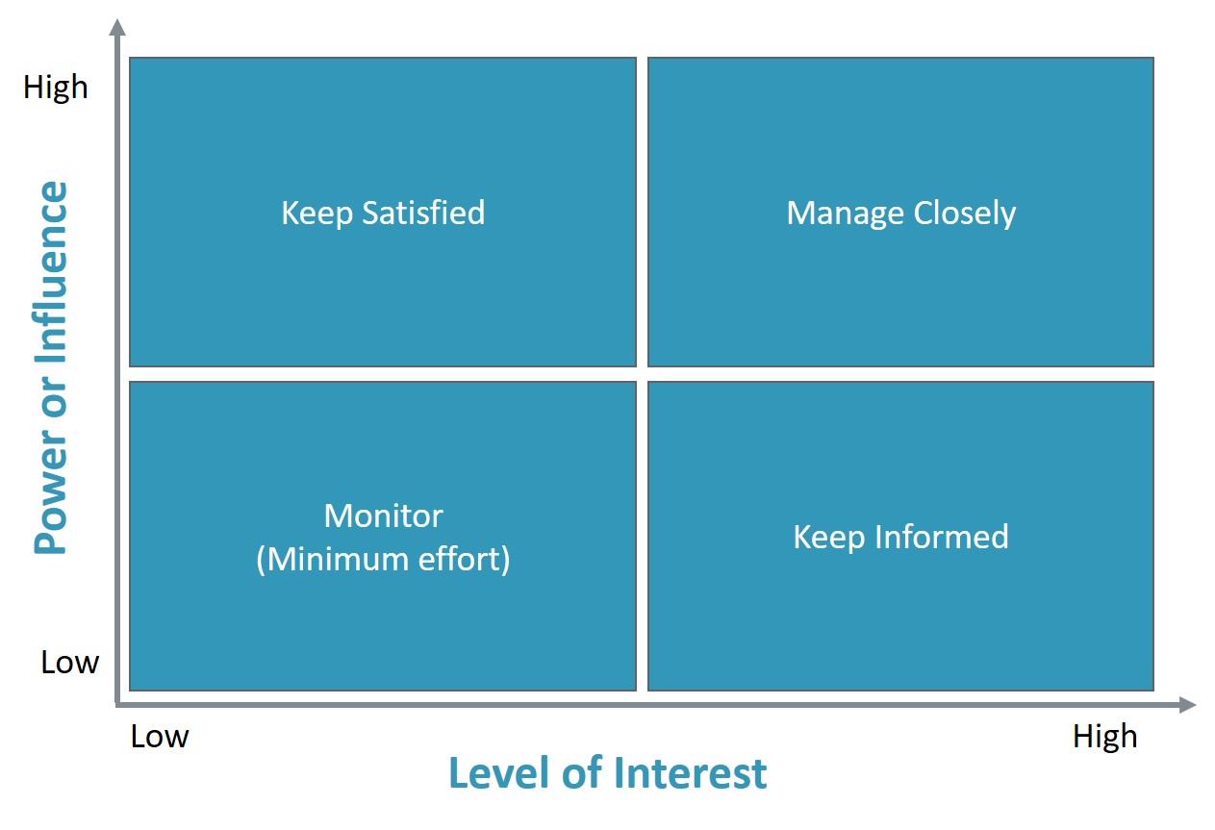
Power interest matrix

Slide 11
Power interest matrix
High power – High interest: these stakeholders are likely to be decision makers and have the biggest impact on the project success. You need to keep these stakeholders close, to manage their expectations.
High power – Low Interest: these stakeholders need to be kept in the loop with what is happening on the project. Even though they may not be interested in the outcome, they yield power. These type of stakeholders should be dealt with cautiously because they could use their power in a negative way if they become unsatisfied.
Low power – High interest: keep these people adequately informed, and talk to them to ensure that no major issues are arising. These people can often be very helpful with the detail of your project.
Low power – low interest: monitor these people, but do not spend time and energy with excessive communication.

Slide 12
The nature of the programme
Information campaigns: seek to transmit information and do not encourage dialogue. They are essentially one way.
Persuasion campaigns: seek to persuade people to a particular view, ie to affect their attitudes or to influence their behaviour in some way.
Deliberative engagement’: Deliberative engagement’ is a phrase used to describe dialogue-based campaigns that result in decision making by the target public, which are then taken up by the organization initiating the dialogue.

Slide 13
CONSTRUCTING THE CONTENT
Rational content
There are four kinds of proposition:
Fact: based on what actually exists or is the case and is provable. Facts are often used to enhance awareness or understanding.
Conjecture: based on what it is reasonable to conclude given the evidence and inviting the identified public to agree. Conjecture is used to gain acceptance and/or support.
Value: these types of proposition focus on the virtue or intrinsic worth of something. This aims to increase interest or build positive opinions. For example, the merits of giving asylum to a persecuted minority may be argued on virtue grounds.
Policy: argues for the adoption of a new policy, and is aimed at forming opinions and affecting behaviour. For example, advocating an increase in the school-leaving age.

Slide 14
CONSTRUCTING THE CONTENT
Propositions are backed by strong arguments and proof wherever possible. Where action is required they are also accompanied by the removal of any barriers. Smith goes on to say that physical evidence to support propositions is the most compelling, but in many situations that is just not available. There are other types of ‘evidence’ that can be used where it is impossible to provide physical evidence. For example:

Slide 15
CONSTRUCTING THE CONTENT
Analogies: using familiar situations and illustrations to draw parallels so that understanding is facilitated. Analogies are often presented as similes or metaphors. So, for example, twittering can be likened to gossiping, only on the internet.
Comparisons: by identifying a particular characteristic or value relating to an issue and then making positive or negative association with something familiar. Comparing political parties’ records on education with one another will put one or the other in a better light.
Examples: the public is able to draw conclusions because of examples that are relevant. For example, you know this product is reliable, because the other six in the range have all been so.
Statistics: to provide reliable evidence that claims are true. For example, this is a good school because we have statistics to prove excellent pupil performance over 10 years.

Slide 16
CONSTRUCTING THE CONTENT
Testimonials and endorsements: testimonials are provided by people who have used services and products. Endorsements are provided by people who are prepared to back the cause or the ideas of the organization. For example, testimonials about services provided by a firm of accountants are a common feature of their publicity material. Endorsements are often sought from celebrities, for example celebrities supporting fundraising efforts on telethons.
Case studies: detailed examples provided by users of services or products, or of causes that have been supported that encourage adoption by others.
Visual evidence: such as photographs, charts, blogs, online videos, animated websites, diagrams, illustrations and so on all add power to content.
Demonstrations, presentations, exhibitions: often provide a way to present first-hand experiences of products or services

Slide 17
Emotional appeal
Emotions are used either positively or negatively. Smith provides four examples of positive emotional appeals:
Love appeals
Virtue appeals
Humour appeal
Sex appeal

Slide 18
Emotional appeal
Smith also provides two examples of content based on negative emotion:
Fear appeal
Guilt appeal

Slide 19
CRAFTING MESSAGES
There are four steps in crafting persuasive messages:
Step one is to take existing articulated perceptions. For example, it may be that an organization’s products are regarded as old-fashioned and this has been identified in earlier research.
Step two is to define what shifts can be made in those perceptions. If, in fact, the products have been substantially upgraded this needs to be said loud and clear.
Step three is to identify elements of persuasion. The best way to do this, as indicated earlier, is to work on the basis of fact. The organization might be making major investments in upgrading their plant. It could be that there has been a series of new technology initiatives. Maybe they have won an innovation award recently. These are all facts that falsify the view that their products are old-fashioned.
Step four is to ensure how the messages can be credibly delivered through public relations.

Slide 20
HOW THE MESSAGE SHOULD BE PRESENTED
The integrity of a message is affected by a whole host of things that determine whether it is taken seriously or not:
Format
Tone
Context
Timing
Repetition

Slide 21
HOW THE MESSAGE SHOULD BE PRESENTED
On top of these points there are three things that need to be said about the source from which content or messages emanate:
Credibility
Personability
Control

