Slide 1
Research and analysis
Ch- 4

Slide 2
EMBEDDING RESEARCH IN THE PLANNING PROCESS
In recent years there has been a drive in both the public and private sectors, to have evidence-based inputs to decision making.

Slide 3
Formative research
Situation analysis
• analysing the environment
• analysing the organization
• analysing stakeholders and publics
• identifying the specific problem(s)/opportunities that need to be addressed Formative research

Slide 4
Program research
Strategy
• defining aims and objectives
• determining stakeholders/publics involved • identifying content of programme
• clarifying overall strategy and approach

Slide 5
Monitoring research
Implementation
• tactical programme
• timescales
• resources

Slide 6
Evaluative research
Evaluation
• evaluation of programme

Slide 7
First planning step
For new campaigns or programmes it is vitally important to undertake a situation analysis – formative research. This research falls under four headings: a) analysing the environment; b) the organization; c) stakeholders and publics; and d) identifying and clarifying the specific issues (positive and/or negative) that need to be addressed.

Slide 8
Situation analysis: Formative research
Initial clarification:
How long have numbers been declining?
What are the demographics of our volunteers (eg age, gender, geography, income)? Can we draw conclusions about which groups in the volunteer community are declining?
What are the travel patterns of our volunteers? l What type of work is most/least popular, etc?
Analysis of the environment:
What are the broader social changes that might affect volunteering?
Are there pertinent economic changes?
Are there regulatory constraints? For example, new legislation affecting those who interact with vulnerable adults? And so on.
Analysis of the organization:
Have there been changes in the organization that might affect volunteers, eg the way we communicate, travel expenses policy, management changes, changes in the location of premises, working hours, etc.
Stakeholders and publics:
Who is involved? Do we have a deep understanding of our volunteers and of their issues and aspirations? Why do they volunteer? Why do they think numbers are declining? l Who else is involved? How? Why? What is the nature of their stake? Who else should be involved? How? Why? etc.

Slide 9
Analyzing the Environment: PEST
The four areas are: Political, Economic, Social and Technological.
The main questions to ask when undertaking a PEST analysis are: What are the environmental factors that affect the organization? Which of these are currently most important? Which will be most important in the next four years? For public relations practitioners other questions need to be asked:
How will these factors impact on our reputation?
How will they impact on our existing relationships?
Will we need to develop new ones? With whom?
Will these factors mean we have to change the culture of our organization?

Slide 10
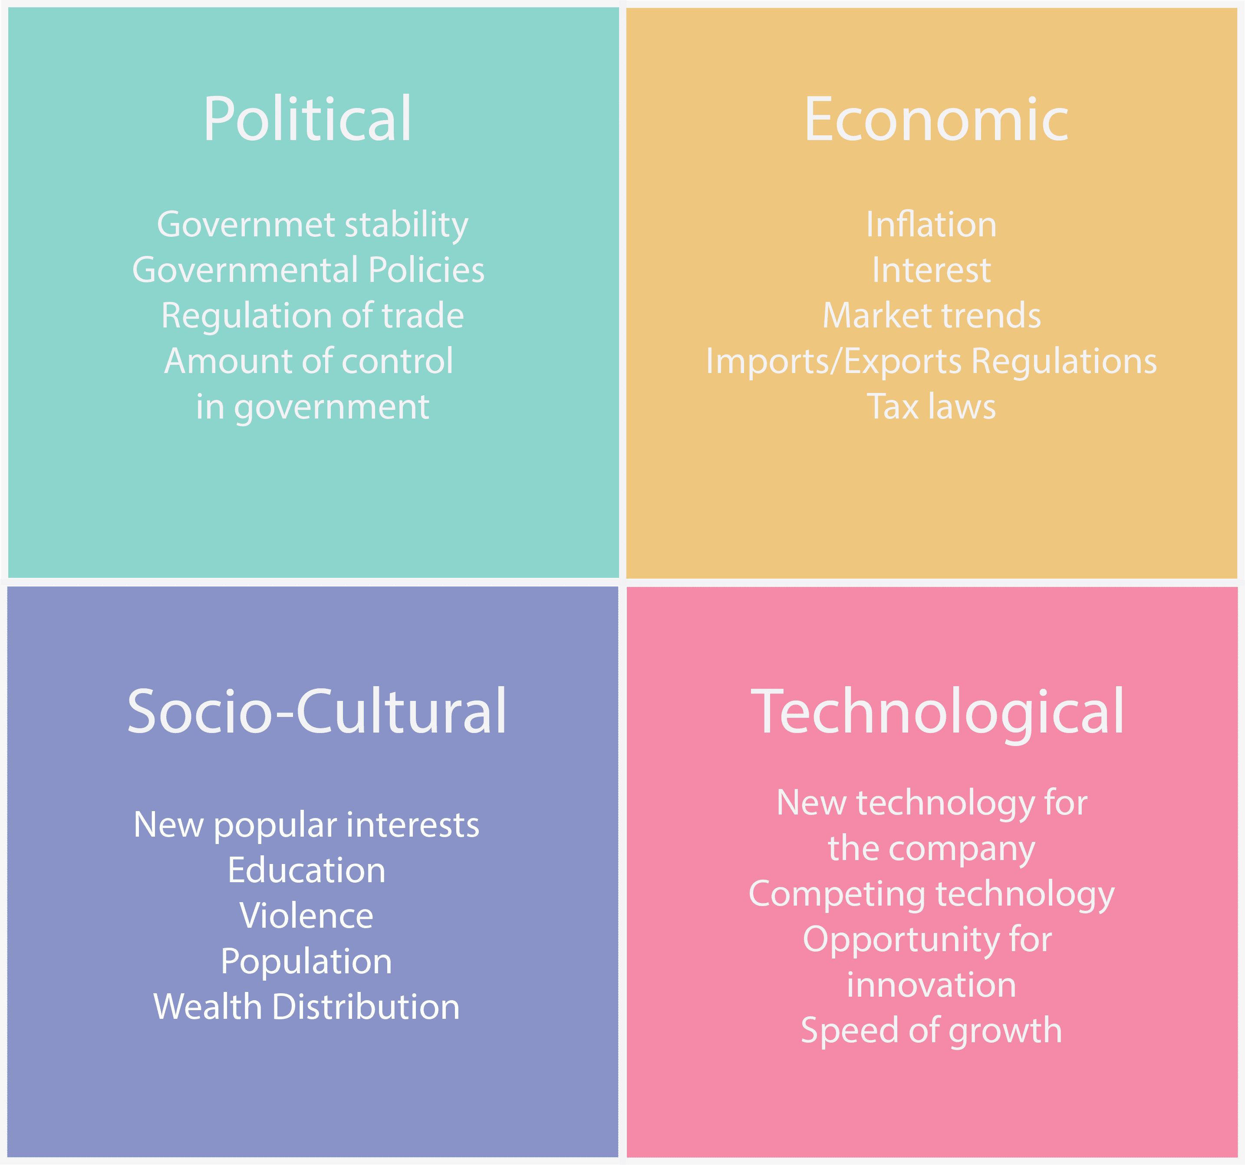
PEST

Slide 11
Issues management
Issues analysis works in both directions: detecting those external factors, political, economic, social or technological that require the company to change; and identifying those areas where it might have an input into the public debate and influence the outcome.

Slide 12
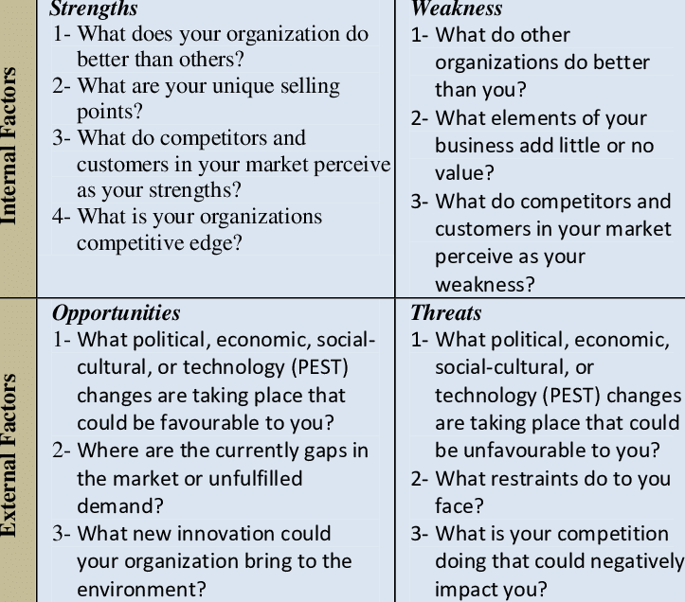
Analyzing organization

Slide 13
Analyzing the stakeholder
The third element of situation analysis is to investigate the current state of stakeholder and publics’ attitudes, opinions and behaviours towards the organization.Smith calls this ‘analysing public perception’ and says there are two elements to this:
Visibility: that is the extent to which the organization is known. Do people know about it? What do they know and is this accurate?
Reputation: how do people regard the organization? Their perceptions will be based on ‘the verbal, visual and behavioural messages, both planned and unplanned, that come from an organization’ .
If an organization has good visibility and a strong reputation, it will be easier to build on this. If it does not, then the reverse is true.

Slide 14
Prioritizing and linking issues
External analysis top prioritized issue : Ethical sourcing
Internal analysis top prioritized issue : Employer of Choice
Stakeholder analysis top prioritized issue : Stakeholder policy questioned

Slide 15
WHO SHOULD UNDERTAKE THE RESEARCH?
Research consultancy or trained in-house people

Slide 16
Research methods
Quantitative, qualitative, mixed and tracking research

Slide 17
Research techniques
Self-completion questionnaires
One-to-one depth interviews
Telephone interviews
Focus groups
Internet groups
Observation
Informal research
Media research

Slide 18
Communication audit
A communication audit entails a comprehensive review of your organization's communications, and feedback from your stakeholders, to determine what's working, what isn't working and where improvements can be made.

Slide 19
Interpreting the findings
Collecting data can be a complex task but what should be done with it once it has been obtained? At the risk of becoming repetitive, it is important to stress that analysing and interpreting data is a highly skilled job.

