Slide 1
Evaluation structures and processes
Ch- 5

Slide 2
Evaluation structures and processes
It is increasingly recognized that the evaluation of public relations programmes/activities requires a mix of techniques: ‘In most cases, a skilled practitioner will use a combination of methods to evaluate the effectiveness of a program’ (Wilcox et al, 2000: 193). This is confirmed by experienced practitioner Walter Lindenmann in his seminal article (1993: 9): ‘it is important to recognize that there is no one simplistic method for measuring PR effectiveness.

Slide 3
The Preparation, Implementation and Impact model
The ‘preparation’ level considers whether adequate background information has been collected to plan the programme in an efficient and effective way. Besides, the content of materials is examined to make sure that it matches the designed plan. The quality of message and presentation of materials are also considered.
At the ‘implementation’ level, evaluation takes into account how tactics have been applied. Specifically, the authors examine the distribution of materials, the number of implemented activities, and the number of those who received messages and attended activities.
The third level of the model examines the impact of a PR programme, that is the extent to which the outcomes outlined in the objectives for the programme have been achieved. This level requires direct measurement using research techniques, and an understanding of how to employ these techniques as well as a certain level of creativity in establishing indicators for behavioural, social and cultural changes.

Slide 4
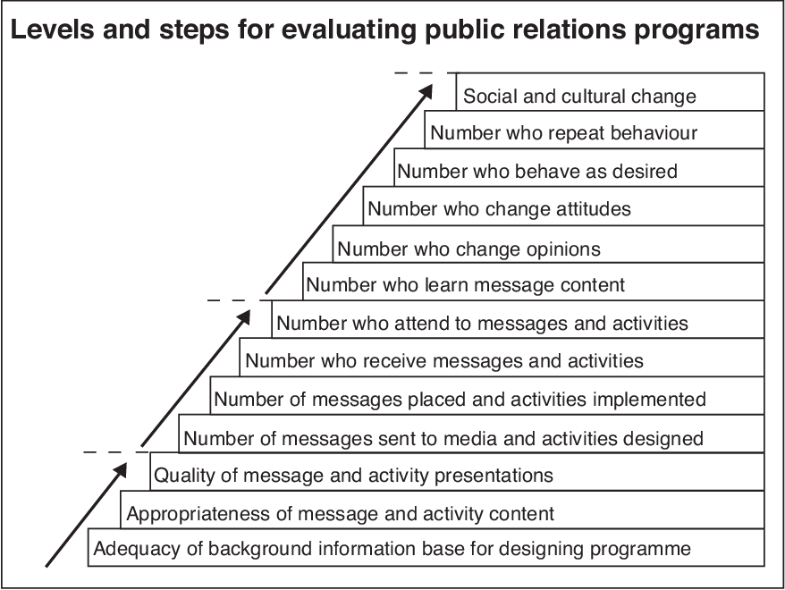
The Preparation, Implementation and Impact model

Slide 5
Macnamara’s Pyramid Model
The Pyramid model, created by an Australian evaluation specialist Jim Macnamara (Figure 4), has a bottom-up structure, with the base of the pyramid being the starting point of the strategy and the peak being the outcome of the campaign. According to Macnamara (2005b, p.264):
“The pyramid metaphor is useful in suggesting that, at the base when communication planning begins, practitioners have a large amount of information to assemble and a wide range of options in terms of media and activities. Selection and choices are made to direct certain messages at certain target audiences through certain media, and ultimately, achieve specific defined objectives (the peak of the programme or project).”

Slide 6
Macnamara’s Pyramid Model
Further, the pyramid consists of three parts: inputs, outputs, and outcomes. Inputs are elements of communication projects and programmes and include the following: the choice of medium, content of communication as well as format. Outputs, in turn, are the materials and activities created (e.g. promotional materials, events, and media publicity) and the process to create them. Outcomes are the impacts and effects of communication efforts. To find out whether the target audience has changed its behaviour or attitude, a number of methodologies can be used – ranging from desktop research to observation and quantitative or qualitative research.

Slide 7
Macnamara’s Pyramid Model
The author also argues that the key processes in the pyramid model have been derived from the PII model and that his model offers and extra value by adding measurement methodologies for each of the three steps (Macnamara, 2005b. p. 266-67). Moreover, to allow data to be integrated into the ongoing monitoring and development of communication programmes and projects, the pyramid model includes formative and summative research methods.

Slide 8
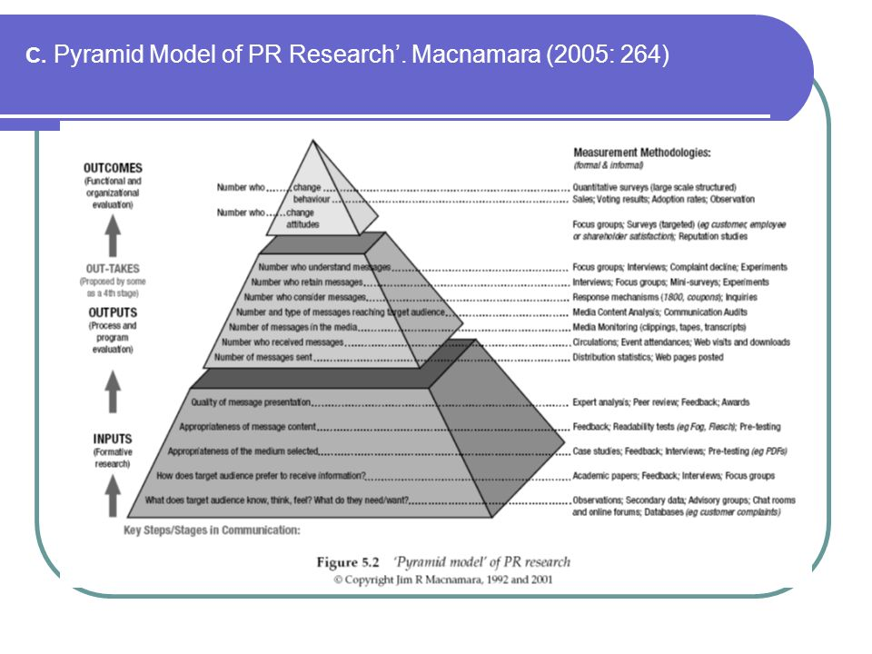
Macnamara’s Pyramid Model

Slide 9
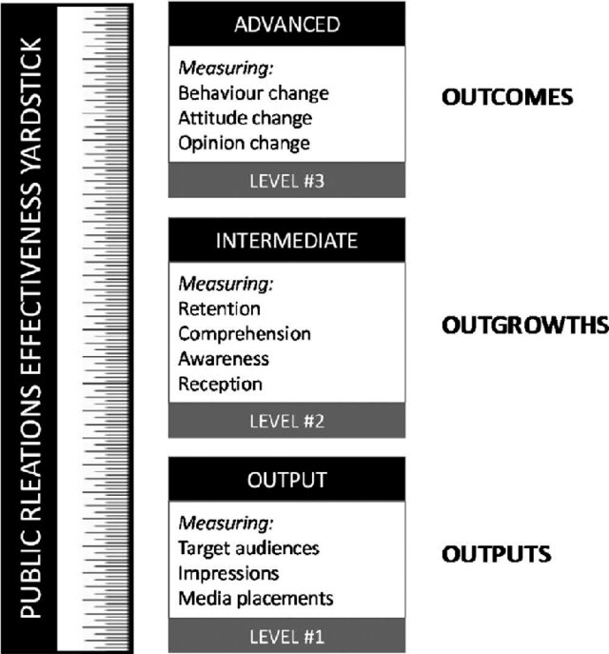
Yardstick model

Slide 10
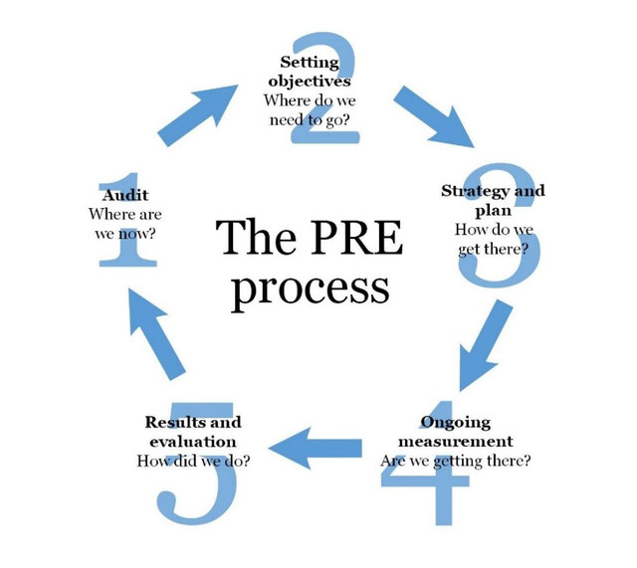
CIPR’s Planning, Research and Evaluation (PRE) process

Slide 11
CIPR’s Planning, Research and Evaluation (PRE) process
The first step in the process is concerned with doing research and gathering information to form a base on which the campaign or programme is based. The SMART (specific, measurable, achievable, realistic and timely) objectives, which are also aligned with the overall business goals, are set during the second step. The third step deals with the strategy and its implementation. Besides, during this stage practitioners should decide upon the type of measurement to be used and pre-test PR techniques and messages to be deployed. Further, the fourth step deals with the ongoing measurement when checks are made and adjustments are introduced, if necessary. The fifth step deals with the examination whether and to what extent the set objectives for the campaign or programme have been achieved.

Slide 12
Dynamic, circular, feedback-oriented PRE process
PRE steps 1 and 2 (audit and objectives) use research as input, PRE step 3 (strategy and plan) pre-tests and informs the choice of and implementation of tactics, PRE step 4 (ongoing measurement) uses tracking research to monitor progress, and step 5 (results and evaluation).

Slide 13
Unified model
Input stage (Planning and preparation)
Output stage (Messages and targets)
Impact stage (Awareness and information)
Effect stage (Attitude and motivation)
Result stage (Behaviour and action)

Slide 14
Short term model of evaluation
The Short Term model has a single track, linear process with an outcome. It does not set out to measure effects and because it does not have a continuing existence, there is no feedback mechanism. Typically, a public relations campaign has a simple awareness objective with one or two strategies. A common example of public relations practice in the Public Information summation is the distribution of news releases about products or services to the media. This is a technician skill of assembling information and photographs or drawings in the manner most acceptable to the media. Measuring achievement of the objectives can be by media analysis, sales responses or phone research among the target audience

Slide 15
Continuing model of evaluation
This model has been designed for use in long term public relations activity. In reviewing the case studies, the need for a dynamic model to cope with ever-changing circumstances was identified. A programme such as that for the new settlement, with multiple long term corporate and planning objectives, or for the industrial redevelopment, with a medium term objective of planning permission and a long term objective of improved relations with the local community, needed a flexible evaluation model.

Slide 16
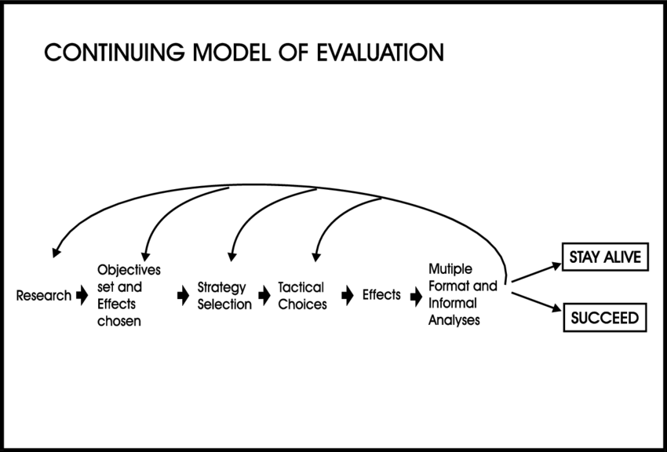
Continuing model of evaluation

Slide 17
Effects-based planning
To develop a more complete approach to planning (and subsequent evaluation) is the purpose of the ‘effects-based planning’ theories put forward by VanLeuven et al (1988). These are closely associated with management-by-objectives techniques used widely in industry and government. Underlying VanLeuven’s approach is the premise that a programme’s intended communication and behavioural effects serve as the basis from which all other planning decisions can be made.

Slide 18
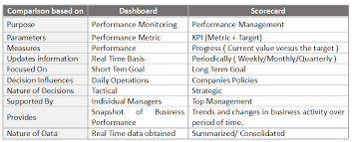
DASHBOARDS AND SCORECARDS

