Slide 1
Evaluation and communication psychology
Ch- 2

Slide 2
Media Effects Theory
In the 1930s, there were studies that argued that the mass media had a powerful and continuing ability to influence public behaviour.
During the next two decades, there was a swing to the reverse argument that mass media did not have a persuasive impact, the so-called 'minimal effects’ theories.
This suggests that ideas flow from the media to opinion leaders in local communities who pick up those ideas that they agree with and spread them to other people, and this face-to-face contact is more powerful than media influence.

Slide 3
Key Concepts
From these theories, the genesis of many current attitudes and public relations practices can be found. Some of the key concepts, outlined by McCoy and Hargie (2003) are:

Slide 4
Key Concepts
Interpersonal influence is very strong and opinion leaders play a vital role in spreading and interpreting information (Lazarsfeld et al, 1948).
Among the barriers that limit campaign effectiveness are: selective exposure – the tendency to attend to messages that are consistent with prior attitudes and experience; selective perception – the tendency to interpret a message in terms of prior attitudes and experiences; and selective retention – the tendency to remember messages that are consistent with prior attitudes and experience (Hyman and Sheatsley, 1947).
Contrasting with this ‘cognitive consistency’ was Festinger’s theory of cognitive dissonance, which said that attitudes can be changed if they are contrasted with a dissonant attitude that is inconsistent with the existing viewpoint (Festinger,1957)

Slide 5
Key Concepts
While Festinger’s theory said that changes in attitudes could come via dissonance, it has become evident over time that people select information because it is relevant to them, rather than because it reinforces existing attitudes (McCoy and Hargie, 2003).
Over time, discussion moved from the impact of mass media to the influence of interpersonal networks. Social learning theorists have pointed out that we create, modify and retain attitudes in discussion with other people in all the social networks. For example, we may see a story in the media but our attitudes towards an issue, ethical stance or product may be formed when discussing it with others in our family, workplace or other social environment.

Slide 6
Domino Model
The domino model is one way of looking at how a message can motivate people to take on different behaviour. It is a four-part sequence based on the concept of a line of dominos- Push one, and the remaining fall in order. It begins with a message, which then implies knowledge. This knowledge influences an attitude, and that is then translated into behaviour.
The domino model is often found in communication strategy documents which propose that a particular approach will almost certainly result in a specific outcome. However, we humans don’t think and act in a mechanistic manner

Slide 7
Output analysis
McGuire’s Output Analysis of the Communication/Persuasion process has attributes that can be considered for persuasion-based public relations evaluation (McGuire, 1984).

Slide 8
Output analysis

Slide 9
Output analysis
1. Exposure / Presentation Audiences are presented with a message through a channel (Eg: Media). This is the easiest step to achieve. 2. Attention / Awareness Audiences will see and recognize the message with either creative exposure, or repeated exposure. Often 3 times or more. 3. Comprehension / Understanding Audiences comprehend the value or point of the message. 4. Acceptance Audiences believe the message. 5. Retention Audiences remember the message, and identify the message with the company and its products / services. Company becomes branded. 6. Action ! Audiences change their behavior in the desired direction. Purchase!

Slide 10
What is PR evaluation
What is evaluation of public relations? Is it measuring output or monitoring progress against defined objectives? Is it giving a numerical value to the results of programmes and campaigns? Is it the final step in the public relations process or a continuing activity?

Slide 11
What is PR evaluation
In the UK, articles in the public relations and marketing press refer to evaluation in terms of ‘justifying expenditure’, which is similar to Grunig and Hunt’s example. White (1991) suggests that company managers have a special interest in the evaluation of public relations: ‘Evaluation helps to answer the questions about the time, effort and resources to be invested in public relations activities: can the investment, and the costs involved, be justified?’

Slide 12
What is PR evaluation
The definitions by many experts emphasize effectiveness, for example: Cutlip, Center and Broom (2006) – ‘systematic measures of program effectiveness’, Pavlik (1987) – ‘evaluation research is used to determine effectiveness’, Blissland (cited in Wilcox et al, 2000) – ‘the systematic assessment of a program and its results’ and Lindenmann (1993) – ‘measure public relations effectiveness’. Developments of these definitions are those which are related to programme or campaign objectives

Slide 13
What is PR evaluation
Definitions of evaluation can therefore be seen to fall into three groups: the commercial, which is a justification of budget spend; simple effectiveness, which asks whether the programme has worked in terms of output; and objectives-effectiveness, which judges programmes in terms of meeting objectives and creation of desired effects

Slide 14
OBJECTIVES OF EVALUATION
Process is ‘the nature of the activities involved in the preparation and dissemination of material’.
Quality is ‘the assessment of materials or programs in terms of accuracy, clarity, design, production values’.
Intermediate objectives which are ‘sub-objectives necessary for a goal to be achieved’, eg placement of news.
Ultimate objectives which are ‘changes in the target audience’s knowledge, attitudes and behaviour’.

Slide 15
The barriers to evaluation
The barriers to the more widespread evaluation of public relations activity are many, as has been demonstrated above. Dozier (1984a) indicated several reasons: previous working experience of practitioners, lack of knowledge of research techniques, the manager/technician dichotomy, the practitioners’ participation in decision-making. Lindenmann (1990) believes that practitioners were "not thoroughly aware" of research techniques. He also found that respondents to his survey complained of a lack of money with 54% spending 3% or less (often much less) on evaluation. Watson (1994) has indicated that time, knowledge, budgets and costs were the principal difficulties for UK public relations people. Baerns (1993) found similar barriers in Germany with time, lack of personnel, inadequate budgets and doubts about the process all being important. Macnamara's research found practitioners lacked knowledge of methodology, but did not explore other explanations.

Slide 16
The barriers to evaluation
These barriers follow a circular argument - most practitioners’ education does not include social science research techniques; therefore they don't use them, but concentrate on technician skills which means they don't rise into the manager roles and participate in decision-making. This would give access to budgets for planning and evaluation, thus creating programmes and campaigns that can enhance their personal standing and meet the objectives of their client or employer

Slide 17
Models of Evaluation
Taking into account the need for accessible, dynamic models of evaluation, two models have been proposed by Watson (1995) - the Short Term model for short time span, largely media relations-based campaigns and activities which seek a rapid result, and the Continuing model for long term activities where the consistent promotion of messages is a central strategy and the outcome may occur after a long period (a year or more) of continuous activity.
These models link with Grunig's four summations of public relations activity (Grunig & Hunt 1984). The Short Term model is similar to the Press Agentry and Public Information one-way summations as it does not seek a dialogue or feedback. The Continuing model fits with the Two-Way Asymmetric and Two-Way Symmetric models which cover a broader band of communication methods and rely on feedback for campaign monitoring and modification of messages.

Slide 18
Short term model of evaluation
The Short Term model has a single track, linear process with an outcome. It does not set out to measure effects and because it does not have a continuing existence, there is no feedback mechanism. Typically, a public relations campaign has a simple awareness objective with one or two strategies. A common example of public relations practice in the Public Information summation is the distribution of news releases about products or services to the media. This is a technician skill of assembling information and photographs or drawings in the manner most acceptable to the media. Measuring achievement of the objectives can be by media analysis, sales responses or phone research among the target audience

Slide 19
Continuing model of evaluation
This model has been designed for use in long term public relations activity. In reviewing the case studies, the need for a dynamic model to cope with ever-changing circumstances was identified. A programme such as that for the new settlement, with multiple long term corporate and planning objectives, or for the industrial redevelopment, with a medium term objective of planning permission and a long term objective of improved relations with the local community, needed a flexible evaluation model.

Slide 20
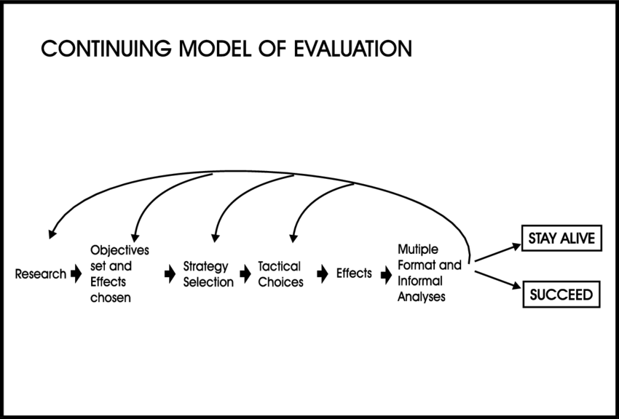
Continuing model of evaluation

Slide 21
Effects-based planning
To develop a more complete approach to planning (and subsequent evaluation) is the purpose of the ‘effects-based planning’ theories put forward by VanLeuven et al (1988). These are closely associated with management-by-objectives techniques used widely in industry and government. Underlying VanLeuven’s approach is the premise that a programme’s intended communication and behavioural effects serve as the basis from which all other planning decisions can be made.

Slide 22
PRINCIPLES OF EVALUATION
Evaluation is research: Evaluation is a research-based discipline. Its purpose is to inform and clarify and it operates to high standards of rigour and logic.
Evaluation looks both ways: Evaluation is a proactive, forward looking and formative activity that provides feedback to enhance programme management. It is also a reviewing, backward looking summative activity that assesses the final outcome of the campaign/programme.

Slide 23
PRINCIPLES OF EVALUATION
3. Evaluation is user and situation dependent: Evaluation should be undertaken according to the objectives and criteria that are relevant to the organization and campaign concerned.
4. Evaluation is short term: Short-term evaluation is usually campaign or project based. Such campaigns are frequently concerned with raising awareness through the use of media relations techniques

Slide 24
PRINCIPLES OF EVALUATION
5. Evaluation is long term: Long-term evaluation operates at a broader, strategic level and usually concerns issues management, corporate reputation, and/or brand positioning.
6. Evaluation is comparative: Evaluation frequently makes no absolute judgements but instead draws comparative conclusions. For example, media evaluation frequently makes historical and/or competitive comparisons, as well as comparing the messages transmitted by the media against those directed at journalists.

Slide 25
PRINCIPLES OF EVALUATION
7. Evaluation is multifaceted: Public relations has been established as a multi-step process, if only because of the additional stepping stone represented by the media.

